Slide 1
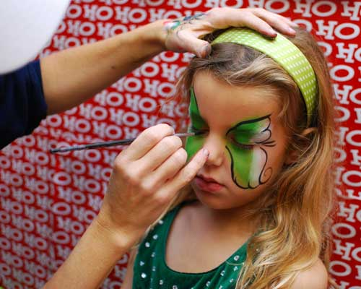
Saturday
November 16, 2013
10:00 am to 3:00 pm
Academy Canada Corner Brook
Have Fun, Stress-Less & Feel Better!
All are Welcome to Visit the Interactive Booths!
Healthy Snack Station
Make Your Own Trail Mix (10:00 to 12:00)
Mini Pizzas (12:00 to 2:00)
Afternoon Pick Me Up! (2:00 to 3:00)
Make Your Own Stress Relievers
Hand & Facial Scrubs
Stress Balls
Flubber & Play Dough
Relaxation Corner Relaxation Techniques to do at home –
Music, Mindfulness, Self Massage
Your Mind & Art - Graffiti Wall
Experience the Therapeutic Benefits of Art
Photo Booth Fun Capture your stress free moment!
Kids’ Zone Events Face Painting, Worry Warriors
Enjoy Mocktails, Smoothies & Fruit Lollipops!
Everyone Welcome!
Admission is FREE
Door Prizes!
For more information, email:
@gmail.com

